Slide 1
Implementation Diagram
Session 23
(Lecture)
Course : Program Design Methods
Effective Period : July 2018

Slide 2
These slides have been adapted from
Britton, C.. (2005). A student Guide to Object Oriented Development. 01. Butterworth-Heinemann. Amsterdam. ISBN: 978-0-7506-6123-2. Chapter 9
Acknowledgement

Slide 3
LO 5 : Explain the object oriented design
Learning Objectives

Slide 4
Contents
Introduction
Architecture
Implementation Diagrams
The user interface
Dealing with persistence data

Slide 5
Introduction
The distinction between analysis and design is that analysis describes what a system must do and design describes how to do it
There are two type of implementation diagram in this stage : component diagrams and deployment diagrams
The component diagram describes the physical software components of the system and their dependencies : such things as executable files, databases, and libraries of classes
The deployment diagram shows the hardware components of the system, i.e computers and their peripherals.

Slide 6
Architecture
The architecture of a system will be consists of software and hardware components of the system.
The software components can be described logically in terms of classes, packages, subsystems, and their dependencies , or physically in terms of executable files, class libraries and databases
Hardware architecture, from the system developer’s perspective is concerned with the computers, peripherals and networks on which the system will run

Slide 7
The component diagram
A component diagram represents the actual physical software components and their dependencies. A component can represent a source, binary file, executable file, database file, a library file or a web page
Component diagram also model the dependencies between components. A dependency between two components represents a usage relationship.

Slide 8
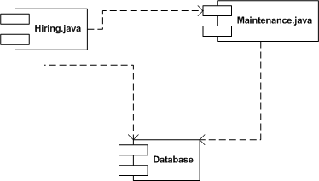
Example

Slide 9
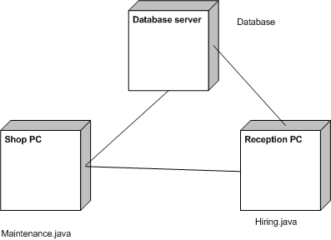
Deployment diagram
Deployment diagrams show the physical arrangement of the hardware elements of computer system
Example : deployment diagram showing a hardware configuration for the Wheels system

Slide 10
The user interface
The interface is what users see and interact with, and if they don’t like it, they won’t use the system
Some general guidelines that are useful when designing any user interface
  The system should be consistent
  User tasks that are boring and prone to error should be minimized
  Screens should be free of clutter, containing al the relevant information and no more
  The dialogue with the system should be easy to follow and it should be obvious to users how to navigate their way through the various screens
  Feedback should be informative, but not intrusive
  The language used in instructions and messages to the user should be clear, concise and free of jargon
  There must be adequate user support with clear instructions, messages and comprehensive on line help

Slide 11
Dealing with persistent data
Guidelines for implementing a class diagram in a relational database
  Tables : the foundation of a relational database is its tables. Each table represents the entity that is important in the system and about which it needs to store information
  Single classes : one class maps onto one table
  One to many associations : there are two ways to implement the one to many association
    Create a table for each of the two linked classes, and a third table to implement the association
    Include a foreign key in the table for the many class
  Many to many association : Create a table for each of the two linked classes, and a third table to implement the association
  Inheritance : there are three ways to implement the inheritance
    Implement the relationship in a single table
    Create table for the subclasses only (if the superclass is abstract)
    Create separate tables for the superclass and each of the subclasses

Slide 12

Example : single class
Bike No | Available | Type | Size | Make | Model | Daily hire rate | Deposit
249 | on hire | mountain | woman's | Scott | Atlantic Trail | £8.00 | £50.00
250 | available | tourer | man's | Releigh | Pioneer | £9.00 | £60.00
251 | on hire | mountain | woman's | Scott | Atlantic Trail | £8.00 | £50.00
252 | on hire | tourer | man's | Dawes | Galaxy | £8.00 | £50.00
253 | available | mountain | child's | Releigh | Chopper | £5.00 | £25.00

Slide 13
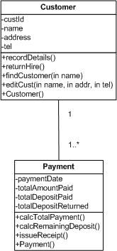
Example : one to many
Customer
CustID | Name | FirstName | Street | Town | PhoneNo
1 | Sykes | Jim | 2 High Road | Greenwood | 01395211056
2 | Perle | Lee | 14 Duke Street | Greenwood | 01395237851
3 | Hargreaves | Les | 11 Forest Road | Prestwich | 01462501339
4 | James | Sheena | 4 Duke Street | Greenwood | 01395237663
5 | Robins | Charlie | 11 Juniper Road | Greenwood | 01395267843
Payment
PaymentNo | Date | Totalamounpaid | Totaldepositpaid | Totaldepositreturned
401 | 19/03/04 | £56.00 | £50.00 | £50.00
402 | 19/03/04 | £20.00 | £25.00 | £25.00
403 | 19/03/04 | £145.00 | £80.00 | £80.00
404 | 20/03/04 | £186.00 | £100.00 | £84.00
405 | 20/03/04 | £44.00 | £40.00 | £40.00
Customer-Payment
CustID | PaymentNo
1 | 409
2 | 513
2 | 405
3 | 404
11 | 501

Slide 14
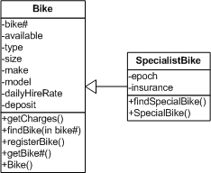
Example : Inheritance
Bike No | Available | Type | Size | Make | Model | Epoch | Insurance | Daily hire rate | Deposit
249 | on hire | mountain | woman's | Scott | Atlantic Trail |  |  | £8.00 | £50.00
250 | available | tourer | man's | Releigh | Pioneer |  |  | £9.00 | £60.00
251 | on hire | mountain | woman's | Scott | Atlantic Trail |  |  | £8.00 | £50.00
252 | on hire | tourer | man's | Dawes | Galaxy |  |  | £8.00 | £50.00
253 | available | mountain | child's | Releigh | Chopper | 193os | £15.00 | £5.00 | £25.00

Slide 15
References
Britton, C.. (2005). A student Guide to Object Oriented Development. 01. Butterworth-Heinemann. Amsterdam. ISBN: 978-0-7506-6123-2.
Deployment Diagram, http://www.tutorialspoint.com/uml/uml_deployment_diagram.htm
Deployment Diagram, http://www.agilemodeling.com/artifacts/deploymentDiagram.htm
Component Diagram, http://www.tutorialspoint.com/uml/uml_component_diagram.htm

Slide 16
Q & A

